Slide 1
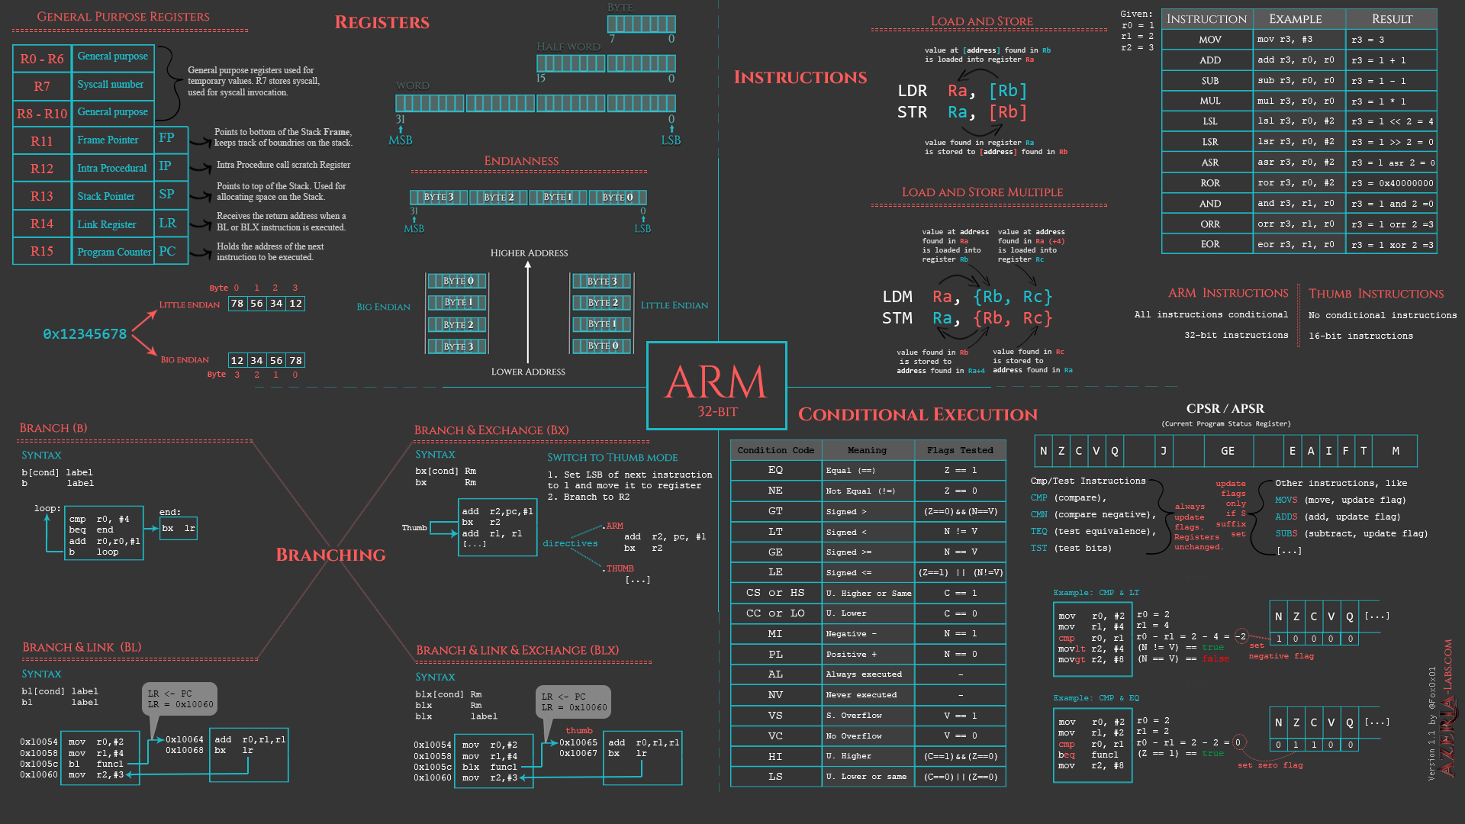
BRANCHING
8086 Assembly
CSE 315 January 2022
Md. Tareq Mahmood
Department of CSE, BUET

Slide 2
Outline
Control Flow Structure
Conditional Jump
Unconditional Jump
Control Flow Structures
IF-THEN
IF-THEN-ELSE
CASE

Slide 3
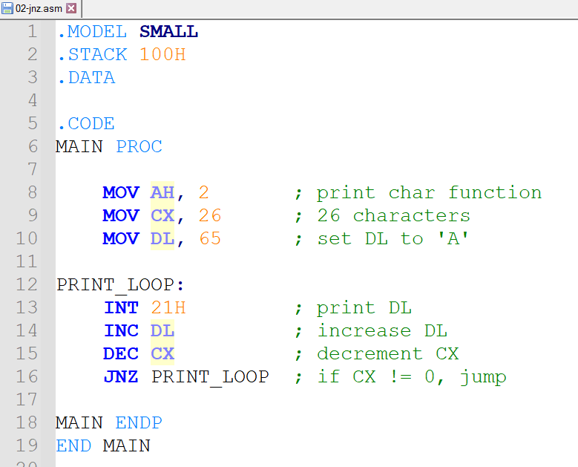
Program to print from ‘A’ to ‘Z’

Slide 4
Conditional Jumps
JNZ is an example of conditional jump instruction
Checks the Z flag. If Z = 0 then jump to the location
Three categories of conditional jumps
Signed jumps, for signed interpretation
Unsigned jumps, for unsigned interpretation
Single-flag jumps, operates on settings of individual flags

Slide 5
The CMP Instruction
The jump condition is often preceded by the CMP (compare) instruction
CMP destination, source
It is like SUB, except that destination is not changed
Destination cannot not be a constant
The result is not stored but the flags are affected

Slide 6
The CMP Instruction
CMP AX, BX
JG BELOW
If AX = 7FFFh, and BX = 0001h,
the result is 7FFFh - 0001h = 7FFEh.
ZF = 0, SF = OF = 0, JG (jump if greater) is satisfied,
so control transfers to label BELOW

Slide 7
Signed Conditional Jumps
Symbol | Description | Condition for jumps
JG/JNLE | Jump if greater than Jump if not less than or equal to | ZF = 0 and SF = OF
JGE/JNL | Jump if greater than or equal to Jump if not less than | SF = OF
JL/JNGE | Jump if less than Jump if not greater than or equal to | SF <> OF
JLE/JNG | Jump if less than or equal Jump if not greater than | ZF = 1 or SF <> OF

Slide 8
Unsigned Conditional Jumps
Symbol | Description | Condition for jumps
JA/JNBE | Jump if above Jump if not below or equal | CF = 0 and ZF = 0
JAE/JNB | Jump if above or equal Jump if not below | CF = 0
JB/JNAE | Jump if below Jump if not above or equal | CF = 1
JBE/JNA | Jump if below or equal Jump if not above | CF = 1 or ZF = 1

Slide 9
Single-Flag Jumps
Symbol | Description | Condition for jumps
JE/JZ | Jump if equal Jump if equal to zero | ZF = 1
JNE/JNZ | Jump if not equal Jump if not zero | ZF = 0
JC | Jump if carry | CF = 1
JNC | Jump if no carry | CF = 0
JO | Jump if overflow | OF = 1
JNO | Jump if no overflow | OF = 0
JS | Jump if sign negative | SF = 1
JNS | Jump if nonnegative sign | SF = 0
JP/JPE | Jump if parity even | PF = 1
JNP/JPO | Jump if parity odd | PF = 0

Slide 10
Range of a Conditional Jump
The destination label must precede the jump instruction by no more than 126 bytes
Or, follow by no more than 127 bytes
LABEL:
; statement
; statement
JNZ LABEL
JZ LABEL
; statements
; statements
LABEL:
; statement
; statement
126 bytes
127 bytes

Slide 11
Signed vs. Unsigned Jumps
Each signed jump corresponds to an analogous unsigned jump
e.g. signed JG corresponds to unsigned JA
Use depends on the interpretation
The jumps operate on different flags
Symbol | Description | Condition for jumps
JG/JNLE | Jump if greater than Jump if not less than or equal to | ZF = 0 and SF = OF
JA/JNBE | Jump if above Jump if not below or equal | CF = 0 and ZF = 0

Slide 12
Signed vs. Unsigned Jumps cont.
For signed interpretation, let us take
AX = 7FFFh, BX = 8000h and we execute
Then, even though 7FFFh > 8000h in a signed sense, the program does not jump to BELOW
Because 7FFFh < 8000h in an unsigned sense
We used JA, which is the unsigned jump
CMP AX, BX
JA BELOW

Slide 13
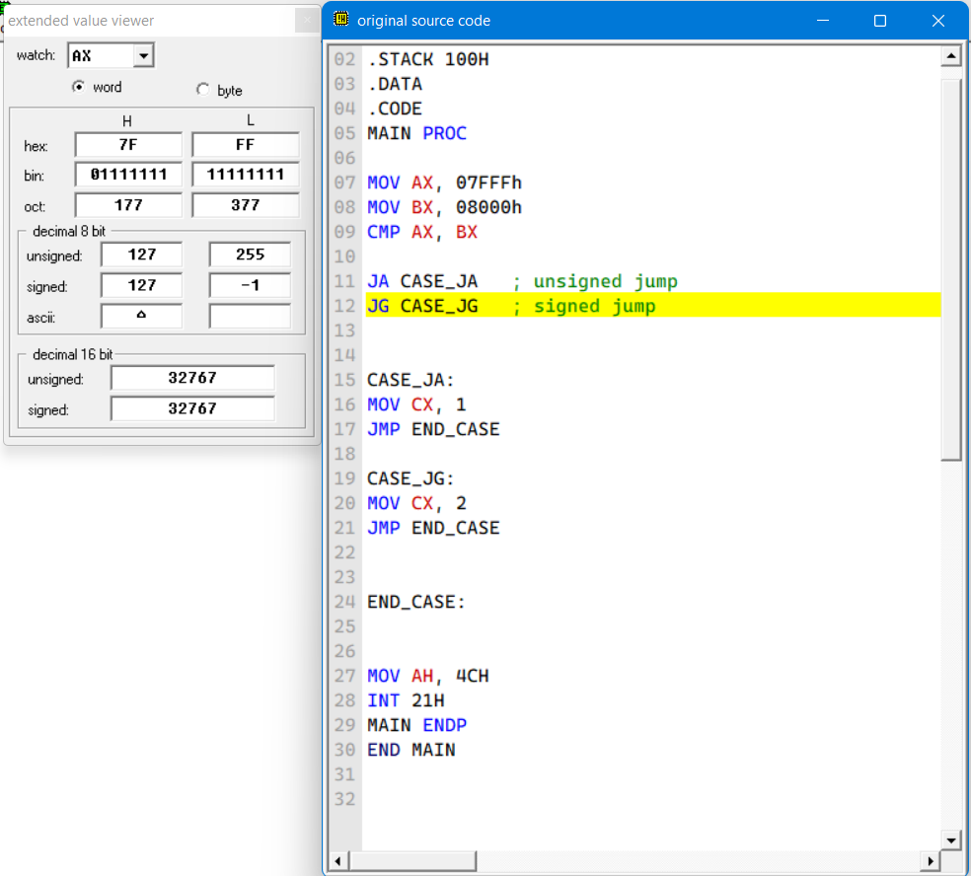
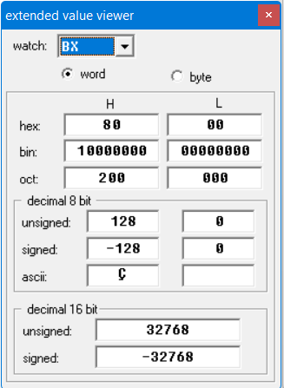

Slide 14
The JMP Instruction
JMP (jump) instruction causes an unconditional jump
The syntax is:
JMP can be used to get around the range restriction
JMP destination
TOP:
; body of the loop, say 2 instructions
DEC CX ; decrement counter
JNZ TOP ; keep looping if CX > 0
MOV AX, BX
TOP:
; body of the loop contains many instructions
DEC CX
JNZ BOTTOM
JMP EXIT
BOTTOM:
JMP TOP
EXIT:
MOV AX, BX

Slide 15
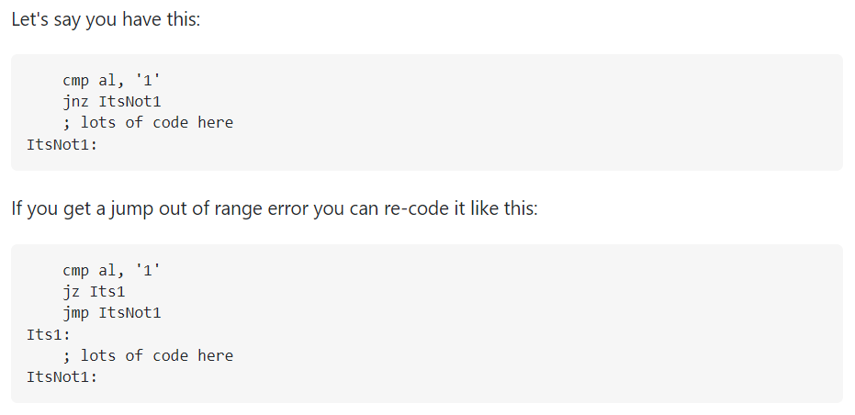
Jump out-of-range solution
https://stackoverflow.com/questions/17307834/jump-out-of-range-solutions-and-how-different-instructions-affect-range

Slide 16
Outline
Control Flow Structure
Conditional Jump
Unconditional Jump
Control Flow Structures
IF-THEN
IF-THEN-ELSE
CASE
Branches with Compound Conditions

Slide 17

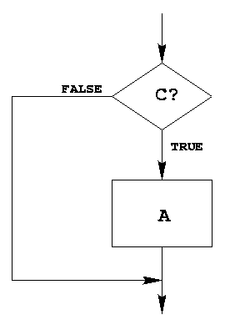
IF-THEN Structure
Replace the number in AX by its absolute value.
IF AX < 0 THEN
replace AX by –AX
END_IF
CMP AX, 0 ; AX < 0?
JNL END_IF
NEG AX
END_IF:
Example 6-2: Assembly Language Programming

Slide 18
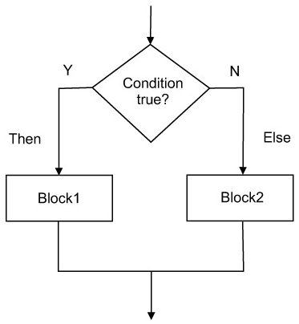
IF-THEN-ELSE Structure
IF AL <= BL THEN
display the character in AL
ELSE
display the character in BL
END_ID
Suppose AL and BL contains ASCII characters.
Display the one that comes first in the character sequence
MOV AH, 2 ; prepare to display
CMP AL, BL ; AL <= BL?
JNBE ELSE_
MOV DL, AL
JMP DISPLAY
ELSE_:
MOV DL, BL
DISPLAY:
INT 21h
END_IF:
Example 6-3: Assembly Language Programming

Slide 19
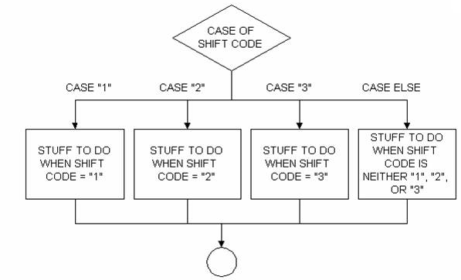
CASE
A CASE is a multi-way branch structure
CASE expression
1: statements_1
2: statements_2
*
*
n: statements_n
END_CASE

Slide 20
CASE Example
If AX contains a negative number, put -1 in BX;
If AX contains 0, put 0 in BX;
If AX contains a positive number, put 1 in BX.
CMP AX, 0 ; test AX
JL NEGATIVE ; AX < 0
JE ZERO ; AX = 0
JG POSITIVE ; AX > 0
NEGATIVE:
MOV BX, -1 ; put -1 in BX
JMP END_CASE ; and exit
ZERO:
MOV BX, 0 ; put 0 in BX
JMP END_CASE ; and exit
POSITIVE:
MOV BX, 1 ; put 1 in BX
END_CASE:
CASE AX
< 0: put -1 in BX
= 0: put 0 in BX
> 0: put 1 in BX
END_CASE
Example 6-4: Assembly Language Programming

Slide 21
More CASE Example
If AL contains 1 or 3, display “o” for odd;
If AL contains 2 or 4, display “e” for even;
CMP AL, 1 ; AL = 1?
JE ODD ; yes, display ‘o’
CMP AL, 3 ; AL = 3?
JE ODD ; yes, display ‘o’
CMP AL, 2 ; AL = 2?
JE EVEN ; yes, display ‘e’
CMP AL, 4 ; AL = 4?
JE EVEN ; yes, display ‘e’
JMP END_CASE
ODD:
MOV DL, ‘o’ ; get ‘o’
JMP DISPLAY ; go to display
EVEN:
MOV DL, ‘e’ ; get ‘e’
DISPLAY:
MOV AH, 2 ; char display function
INT 21h ; display character
END_CASE
CASE AL
1, 3: display ‘o’
2, 4: display ‘e’
END_CASE
Example 6-4: Assembly Language Programming

Slide 22
Outline
Control Flow Structure
Conditional Jump
Unconditional Jump
Control Flow Structures
IF-THEN
IF-THEN-ELSE
CASE
Branches with Compound Conditions

Slide 23
Branches with Compound Conditions
Branching condition in an IF or CASE can be
condition_1 AND condition_2
condition_1 OR condition_2
First one is AND condition
Second one is OR condition

Slide 24
AND Conditions
Read a character into AL
IF (‘A’ <= character ) and (character <= ‘Z’) THEN
display the character
END_IF
Read a character, and if it’s an uppercase letter, display it.
MOV AH, 1 ; read character function
INT 21h ; char in AL
CMP AL, ‘A’ ; char >= ‘A’
JNGE END_IF ; no, exit
CMP AL, ‘Z’ ; char <= ‘Z’
JNLE END_IF ; no, exit
MOV DL, AL ; get char
MOV AH, 2 ; display character function
INT 21h ; display the character
END_IF:
Example 6-6: Assembly Language Programming

Slide 25
OR Conditions
Read a character, and if it’s ‘y’ or ‘Y’, display it; otherwise, terminate the program
MOV AH, 1 ; read character function
INT 21h ; char in AL
CMP AL, ‘Y’ ; char = ‘Y’
JE THEN ; yes, display the char
CMP AL, ‘y’ ; char = ‘y’
JE THEN ; yes, display the char
JMP ELSE_
THEN:
MOV DL, AL ; get the char
MOV AH, 2 ; display character function
INT 21h ; display the character
ELSE_:
Read a character into AL
IF (character = ‘y’) or (character = ‘Y’) THEN
display the character
ELSE
terminate the program
END_IF
Example 6-7: Assembly Language Programming

